Slide 1


Marwadi Education Foundation’s Group of Institutions Faculty of Computer Applications MCA Sem- III
Fundamental of Java Programming
(630002)
Unit – 2
Packages

Slide 2
Introduction
In Simple Words we can say that A package means “putting classes together”.
In a package we can define classes and interfaces.
Concept of package is also known as “Class Libraries” in other languages.
In other words we can say package is a “container for classes and interfaces”

Slide 3
Introduction
The classes contained in the packages of other programs can be easily reused.
Two classes in two different packages can have the same name. At that time we have to refer them with fully qualified name.
package also provides a way to hide classes also.

Slide 4
Types of Packages
Packages can be classified in two different types :
Java API Packages
User Defined Packages
Java API packages means readymade packages given by java.
User Defined packages means the packages developed by us.

Slide 5
Java API Packages
Java
lang
awt
net
util
io
applet

Slide 6
Java API Packages
Package Name | Description
java.lang | Language Support Classes. This package imported itself and includes classes for String, Maths, Threads and Exceptions
java.util | Language utility classes such as vectors, hash tables random numbers, date etc.
java.awt | Set of classes for implementing GUI
java.io | Input output classes – Provides facility for data input and output
java.net | Classes for networking.
java.applet | Classes for creating and implementing applets.

Slide 7
How to use API Packages
We can use Java built in packages by using import statement in our program. At the time of using import statement we have two options either we can import a particular class of the Package
import java.io.DataInputStream;
Or we can import All the classes of Package
import java.io.*;

Slide 8
Static import
By adding the word static after the import keyword, you change your import to a static one. when an import is static, all the accessible methods and variables of the class can be used without prefixing its access with the class name. For instance, if you static import the java.awt.Color class with import static java.awt.Color.*;, you just have to include RED in your code, instead of Color.RED. A simple version of this feature is as follows :

Slide 9
Static import
import static java.awt.Color.*;
public class ImportTest
{
public static void main(String args[])
{
System.out.println(RED);
}
}

Slide 10
Java Naming Conventions
A naming convention is a rule to follow as you decide what to name your identifiers (e.g. class, package, variable, method, etc..).
Whenever we declare any new package, class, method or variable at that time we have to keep in mind these conventions.
Remember that these are not rules but these are only conventions for easy identification of the above mentioned things.

Slide 11
Need for Java Naming Conventions
Different Java programmers can have different styles and approaches to the way they program. By using standard Java naming conventions they make their code easier to read for themselves and for other programmers. Readability of Java code is important because it means less time is spent trying to figure out what the code does, leaving more time to fix or modify it.

Slide 12
Need for Java Naming Conventions
To illustrate the point it's worth mentioning that most software companies will have a document that outlines the naming conventions they want their programmers to follow. A new programmer who becomes familiar with those rules will be able to understand code written by a programmer who might have left the company many years before hand.

Slide 13
Need for Java Naming Conventions
When choosing a name for an identifier make sure it's meaningful. For instance, if your program deals with customer accounts then choose names that make sense to dealing with customers and their accounts (e.g., customerName, accountDetails). Don't worry about the length of the name. A longer name that sums up the identifier perfectly is preferable to a shorter name that might be quick to type but ambiguous.

Slide 14
Different Case Conventions
(1) Lowercase : is where all the letters in a word are written without any capitalization (e.g., while, if, mypackage).
(2) Uppercase : is where all the letters in a word are written in capitals. When there are more than two words in the name use underscores to separate them (e.g., MAX_HOURS, FIRST_DAY_OF_WEEK).
(3) CamelCase : (also known as Upper CamelCase) is where each new word begins with a capital letter (e.g., CamelCase, CustomerAccount, PlayingCard).

Slide 15
Different Case Conventions
(4) Mixed case : (also known as Lower CamelCase) is the same as CamelCase except the first letter of the name is in lowercase (e.g., hasChildren, customerFirstName, customerLastName).

Slide 16
Standard Java Naming Conventions
(1) Packages: Names should be in lowercase. With small projects that only have a few packages it's okay to just give them simple (but meaningful!) names: package pokeranalyzer package mycalculator. In software companies and large projects where the packages might be imported into other classes, the names will normally be subdivided. Typically this will start with the company domain before being split into layers or features: package com.mycompany.utilities package org.bobscompany.application.userinterface.

Slide 17
Standard Java Naming Conventions
(2) Classes: Names should be in CamelCase. Try to use nouns because a class is normally representing something in the real world: e.g.
class Customer
class Account

Slide 18
Standard Java Naming Conventions
(3) Interfaces: Names should be in CamelCase. They tend to have a name that describes an operation that a class can do: e.g.
interface Comparable
interface Enumerable
Note that some programmers like to distinguish interfaces by beginning the name with an "I": e.g.
interface IComparable
interface IEnumerable

Slide 19
Standard Java Naming Conventions
(4) Methods : Names should be in mixed case. Use verbs to describe what the method does: e.g.
void calculateTax()
string getSurname()

Slide 20
Standard Java Naming Conventions
(5) Variables: Names should be in mixed case. The names should represent what the value of the variable represents: e.g.
string firstName
int orderNumber
Only use very short names when the variables are short lived, such as in for loops: for (int i=0; i<20;i++) { //i only lives in here }
(6) Constants: Names should be in uppercase. e.g.
static final int DEFAULT_WIDTH
static final int MAX_HEIGHT

Slide 21
Creation of New Package
Syntax :
package <name of package>;
public class <class name>
{
………….
Body of the Class
………….
}

Slide 22
Creation of New Package
Example :
package firstPackage;
public class FirstClass
{
………….
Body of the Class
…………
}

Slide 23
Creation of New Package
Suppose we have a file called HelloWorld.java, and we want to put this file in a package world. First thing we have to do is to specify the keyword package with the name of the package we want to use (world in our case) on top of our source file, before the code that defines the real classes in the package, as shown in our HelloWorld class below:

Slide 24
Creation of New Package
// only comment can be here
package world;
public class HelloWorld
{
public static void main(String[] args)
{
System.out.println("Hello World");
}
}

Slide 25
Creation of New Package
One thing you must do after creating a package for the class is to create nested subdirectories to represent package hierarchy of the class. In our case, we have the world package, which requires only one directory. So, we create a directory world and put our HelloWorld.java into it.

Slide 26
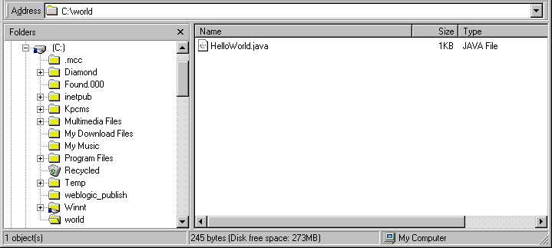
Creation of New Package

Slide 27
Setting up the CLASSPATH
From the above figure, we put the package world under C:. So we just set our CLASSPATH as:
set CLASSPATH=.;C:\;
Note: If you used to play around with DOS or UNIX, you may be familiar with . (dot) and .. (dot dot). We use . as an alias for the current directory and .. for the parent directory. In our CLASSPATH we include this . for convenient reason. Java will find our class file not only from C: directory but from the current directory as well. Also, we use ; (semicolon) to separate the directory location in case we keep class files in many places.

Slide 28
Setting up the CLASSPATH
When compiling HelloWorld class, we just go to the world directory and type the command:
C:\world\javac HelloWorld.java
If you try to run this HelloWorld using java HelloWorld, you will get the following error:
C:\world>java HelloWorld
Exception in thread "main" java.lang.NoClassDefFoundError: HelloWorld (wrong name: world/HelloWorld)

Slide 29
Setting up the CLASSPATH
The reason is right now the HelloWorld class belongs to the package world. If we want to run it, we have to tell JVM about its fully-qualified class name (world.HelloWorld) instead of its plain class name (HelloWorld).
C:\world>java world.HelloWorld
C:\world>Hello World

Slide 30
Setting up the CLASSPATH
Now to make this example more understandable, let's put the HelloWorld class along with its package (world) be under C:\myclasses directory instead. The new location of our HelloWorld should be as shown in Figure.

Slide 31
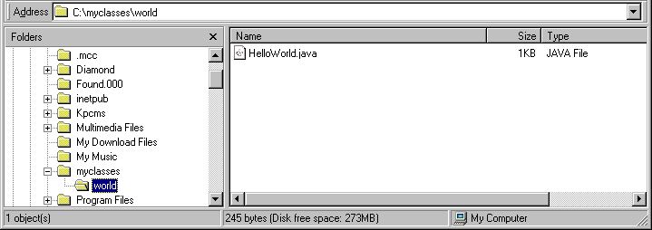
Setting up the CLASSPATH

Slide 32
Setting up the CLASSPATH
We just changed the location of the package from
C:\world\HelloWorld.java
to
C:\myclasses\world\HelloWorld.java.
Our CLASSPATH then needs to be changed to point to the new location of the package world accordingly.

Slide 33
Setting up the CLASSPATH
set CLASSPATH=.;C:\myclasses;
Thus, Java will look for java classes from the current directory and C:\myclasses directory instead. Someone may ask "Do we have to run the HelloWorld at the directory that we store its class file everytime?". The answer is NO. We can run the HelloWorld from anywhere as long as we still include the package world in the CLASSPATH. For example,

Slide 34
Setting up the CLASSPATH
C:\>set CLASSPATH=.;C:\;
C:\>set CLASSPATH // see what we have
CLASSPATH=.;C:\;
C:\>cd world
C:\world>java world.HelloWorld
Hello World
C:\world>cd ..
C:\>java world.HelloWorld
Hello World

Slide 35
Subpackage (package inside another package)
Assume we have another file called HelloMoon.java. We want to store it in a subpackage "moon", which stays inside package world. The HelloMoon class should look something like this:

Slide 36
Subpackage (package inside another package)
package world.moon;
public class HelloMoon
{
private String holeName = "rabbit hole";
public getHoleName()
{ return hole;
}
public setHole(String holeName)
{
this.holeName = holeName;
}
}

Slide 37
Subpackage (package inside another package)
If we store the package world under C: as before, the HelloMoon.java would be c:\world\moon\HelloMoon.java as shown in Figure below :

Slide 38
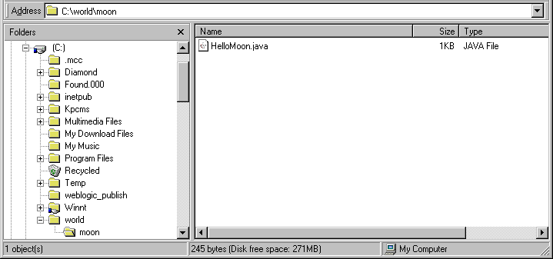
Subpackage (package inside another package)

Slide 39
Subpackage (package inside another package)
If we store the package world under C: as before, the HelloMoon.java would be c:\world\moon\HelloMoon.java as shown in Figure below :

Slide 40
Subpackage (package inside another package)
Although we add a subpackage under package world, we still don't have to change anything in our CLASSPATH. However, when we want to reference to the HelloMoon class, we have to use world.moon.HelloMoon as its fully-qualified class name.

Slide 41
How to use Package
There are 2 ways in order to use the public classes stored in package.
Declare the fully-qualified class name.
For example,
world.HelloWorld helloWorld = new world.HelloWorld();
world.moon.HelloMoon helloMoon = new world.moon.HelloMoon();
String holeName = helloMoon.getHoleName();

Slide 42
How to use Package
2) Use an "import" keyword:
import world.*;
// we can call any public classes inside the world package
import world.moon.*;
// we can call any public classes inside the world.moon package
import java.util.*;
// import all public classes from java.util package
import java.util.Hashtable;
// import only Hashtable class (not all classes in java.util package)

Slide 43
How to use Package
Thus, the code that we use to call the HelloWorld and HelloMoon class should be ... HelloWorld helloWorld = new HelloWorld();
// don't have to explicitly specify world.HelloWorld anymore
HelloMoon helloMoon = new HelloMoon();
// don't have to explicitly specify world.moon.HelloMoon anymore ...
ex\ex22.java

Slide 44
Access Modifiers
Class Modifiers
Keyword | Meaning
abstract | Must be extended
final | Cannot be extended
public | can be accessed by any other class but if the keyword is missing then access is limited to the current package

Slide 45
Access Modifiers
Method Modifiers
Keyword | Meaning
abstract | Must be overridden
final | Must not be overridden
native | Implemented in machine code used by the host cpu not by the Java ByteCode
private | Can be invoked only by the same class
protected | Can be invoked only by code of subclass of same package
public | Can be invoked by any other class
static | Not an instance variable
synchronized | acquires a lock when begins execution

Slide 46
Access Modifiers
Variable Modifiers
Keyword | Meaning
final | It is a constant
private | Can be accessed only by the same class only
protected | Can be accessed only by the class in which it is declared and sub classes of the same package
public | Can be accessed by any other class
static | is not an instance variable

Slide 47
Access Modifiers
Access Modifier and Access Location | Public | Protected | Friendly (default) | Private protected | private
Same class | Yes | Yes | Yes | Yes | Yes
Subclass in same package | Yes | Yes | Yes | Yes | No
Other classes of same package | Yes | Yes | Yes | No | No
Subclass in other package | Yes | Yes | No | Yes | No
Non-subclass of other packages | Yes | No | No | No | No

Slide 48
Access Modifiers
Points to be remember (Summary)
Use public if the field is visible everywhere
Use protected if the field is to be visible everywhere in current package and subclasses of other packages.
Use default if the field is to be visible everywhere in the current package only.
Use private protected if the field if the field is to be visible only in subclasses regardless of package.
Use private if the field is not to be visible anywhere except its own class.
ex\java-access-modifiers.zip

Slide 49
Thank You

